Slide 1
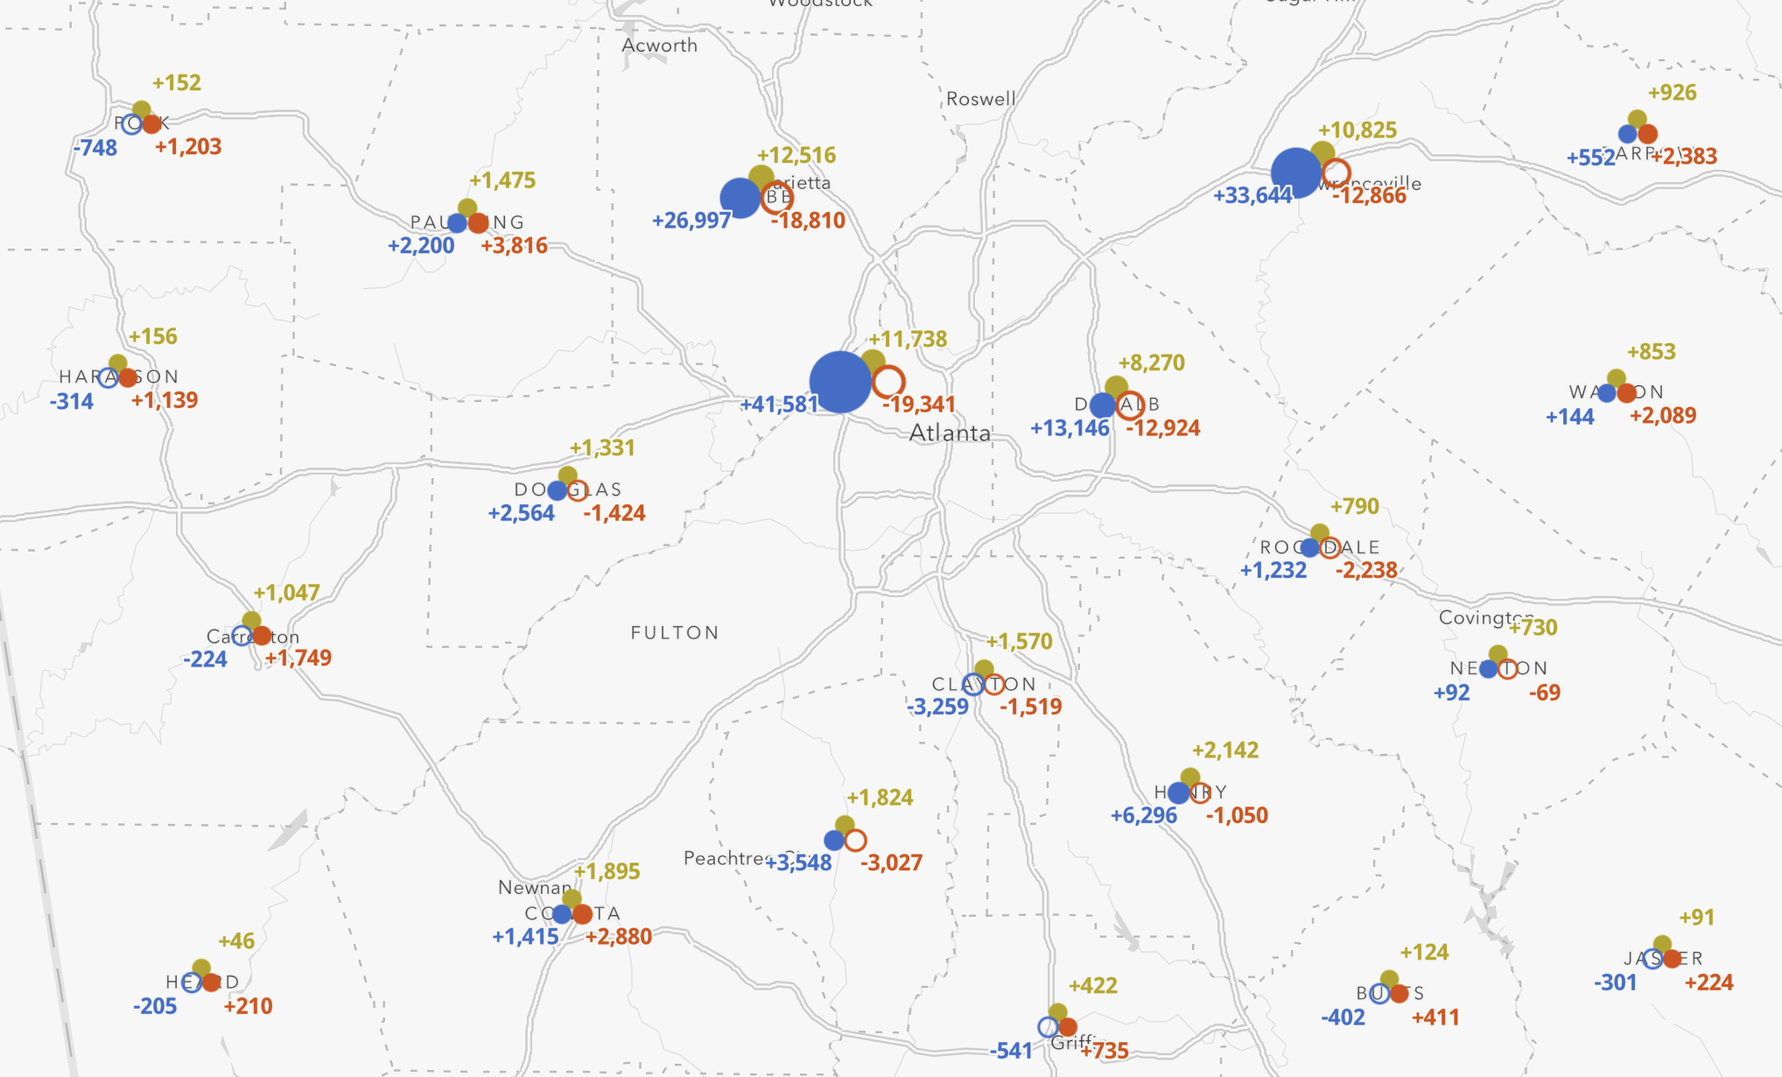
Mapping change and progress with dynamic multivariate composite symbols
Kristian Ekenes, Esri
NACIS 2021

Slide 2
Multivariate composite symbols

Slide 3
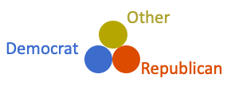
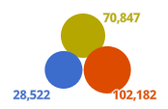
Multivariate composite symbols
Two or more data variables connected to distinct symbol parts/layers
A visual cue (e.g. size or color) for each symbol layer is driven by a data value.

Slide 4
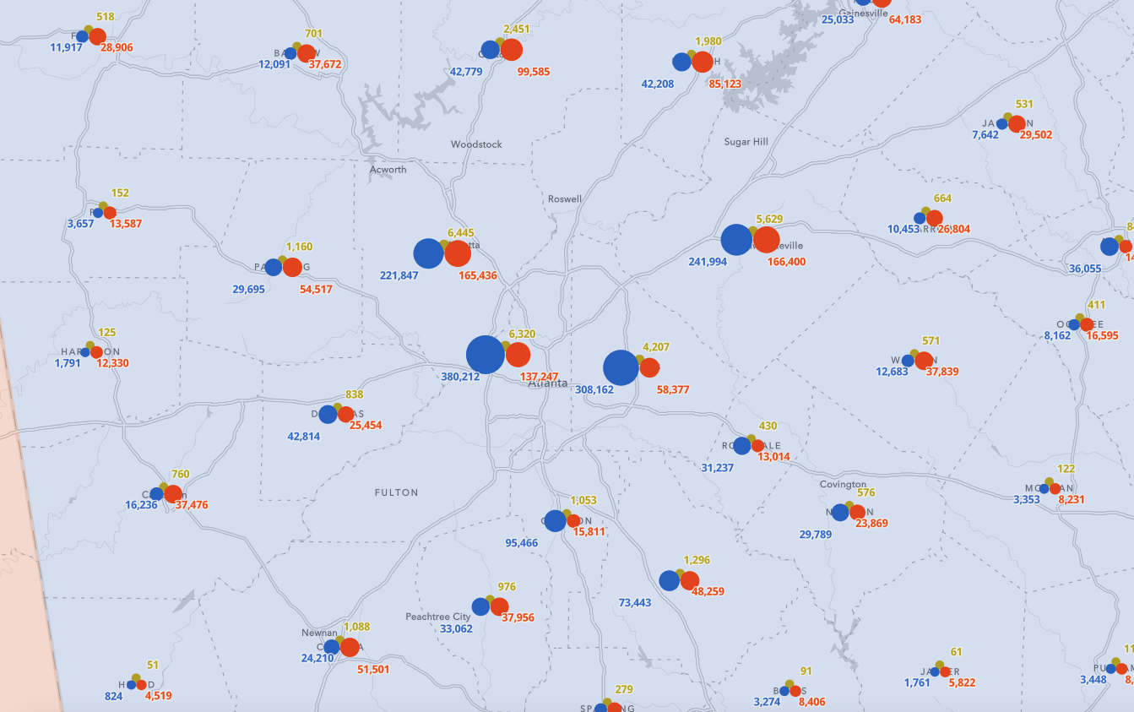

Slide 5
Mapping diverging data using size

Slide 6
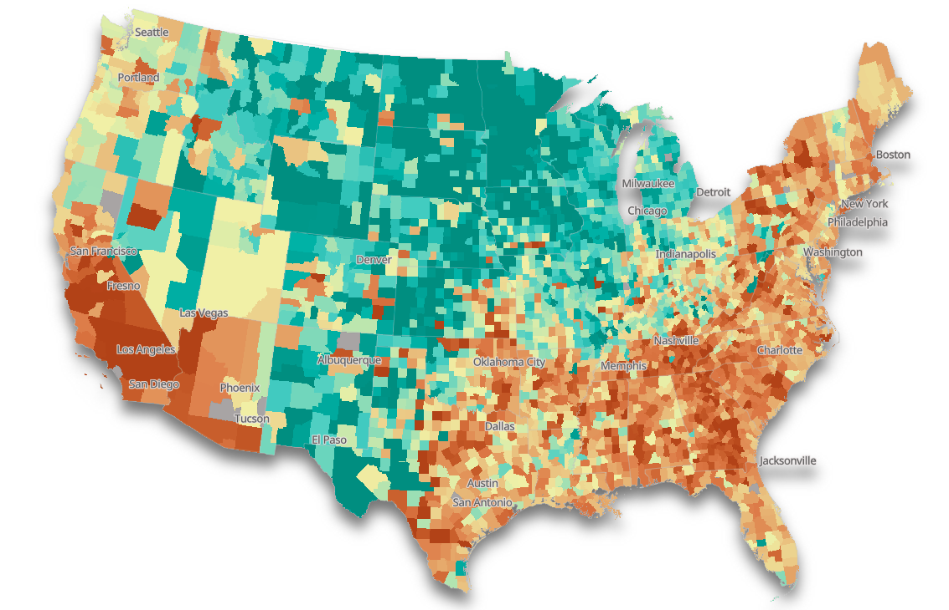
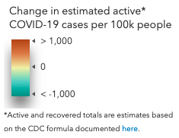
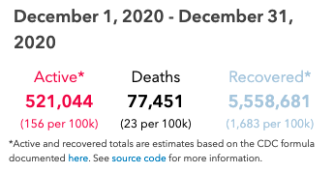
Visualize change with diverging colors

Slide 7
Visualize change with diverging colors and size

Slide 8
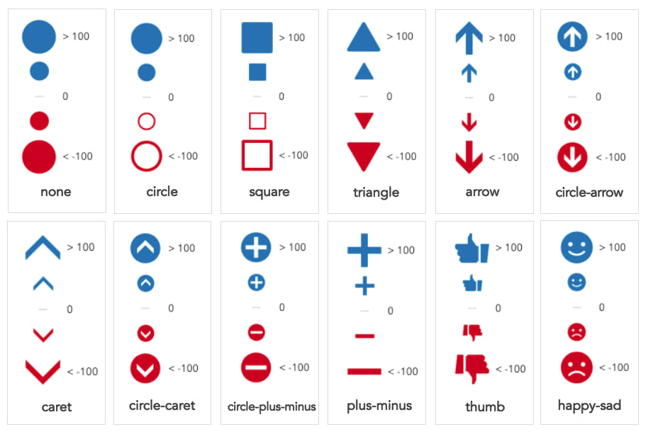

Slide 9
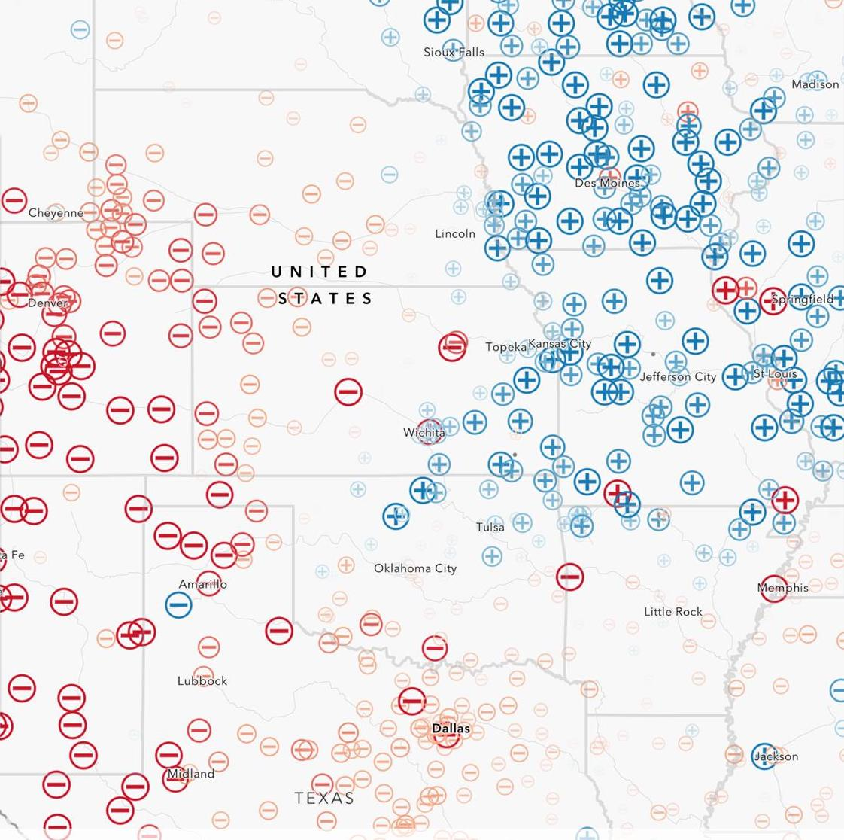
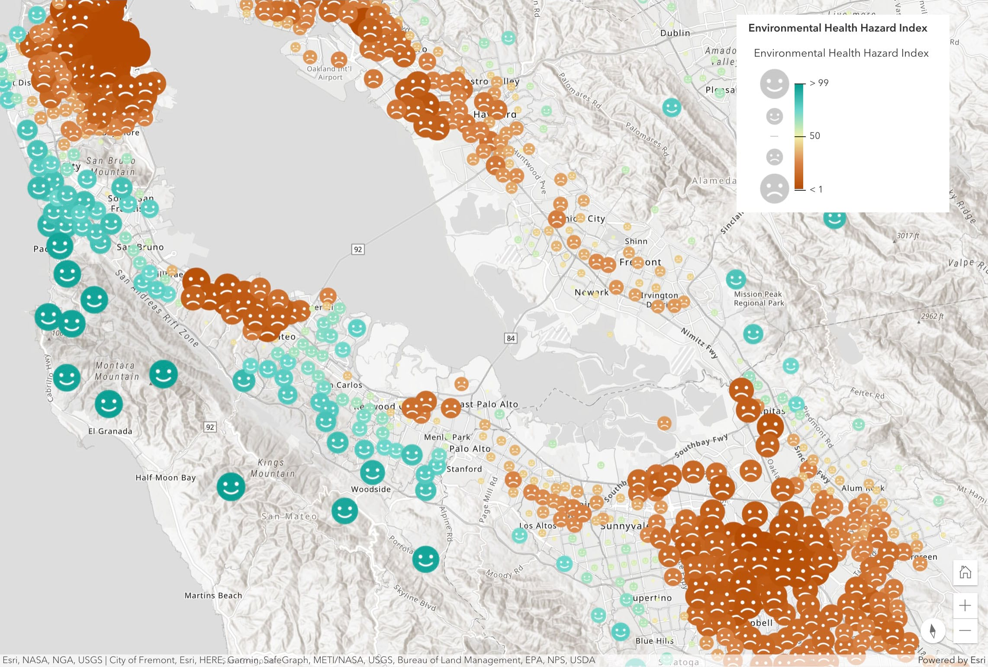
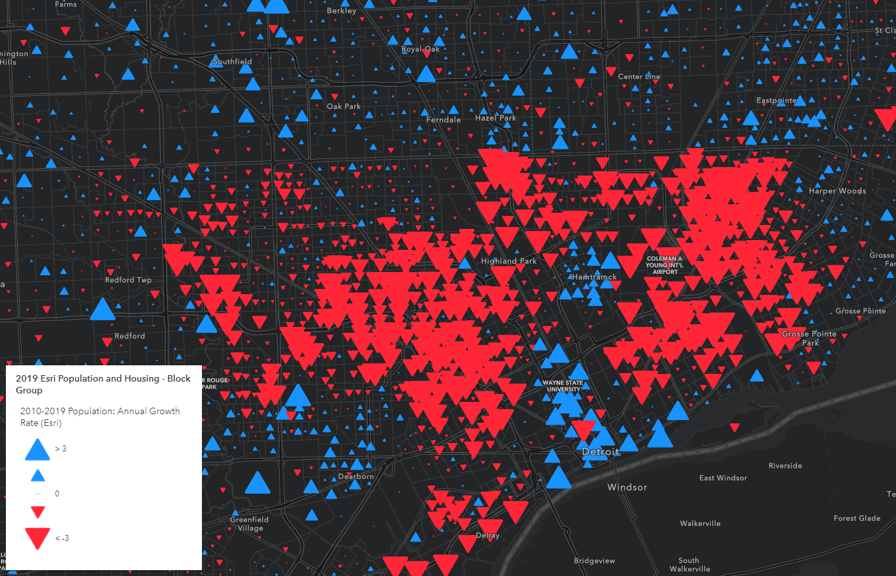
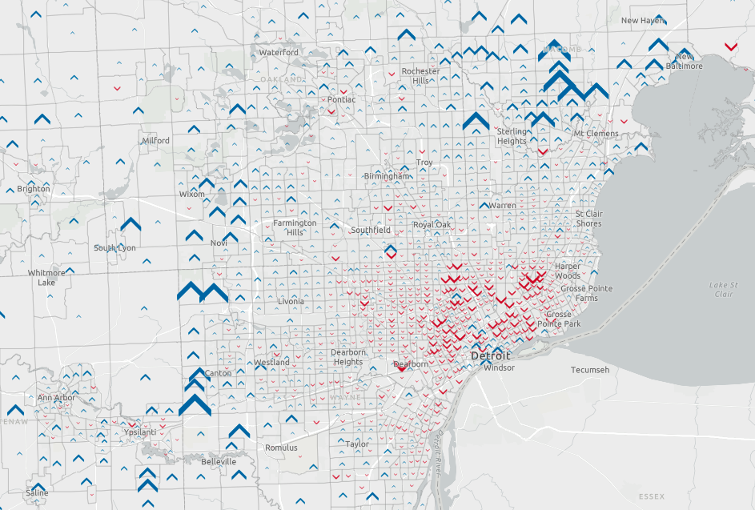
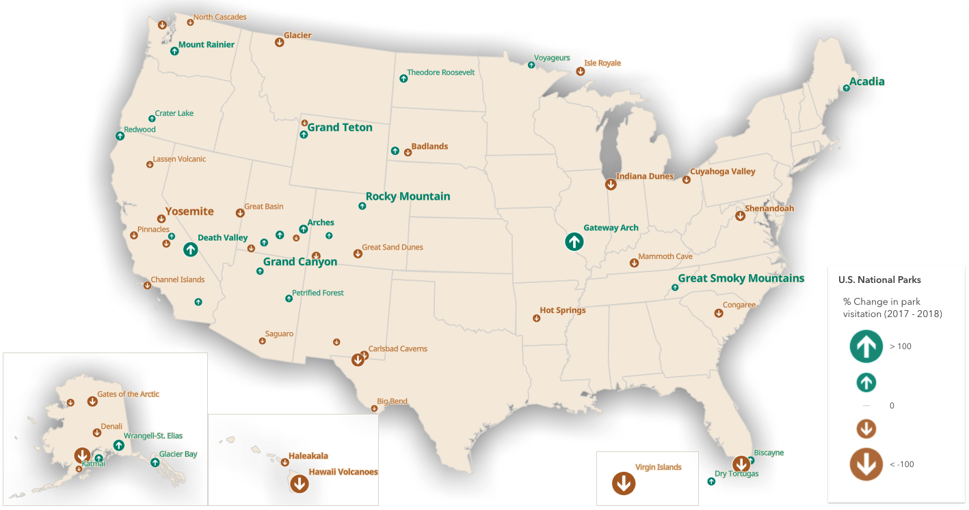

Slide 10
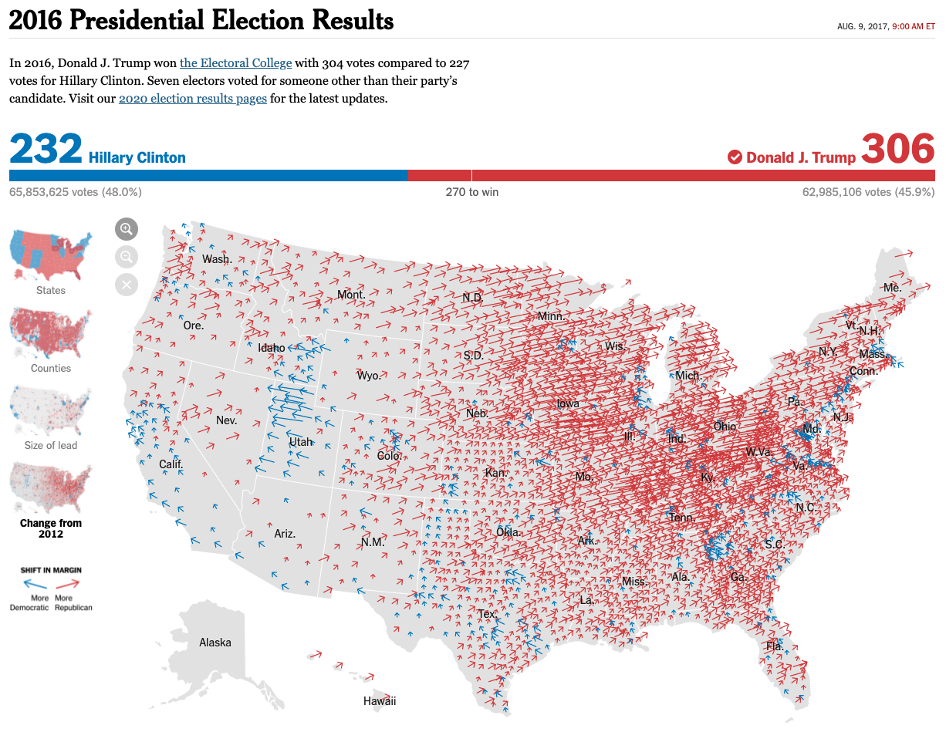
The New York Times

Slide 11
The New York Times

Slide 12
ff

Slide 16
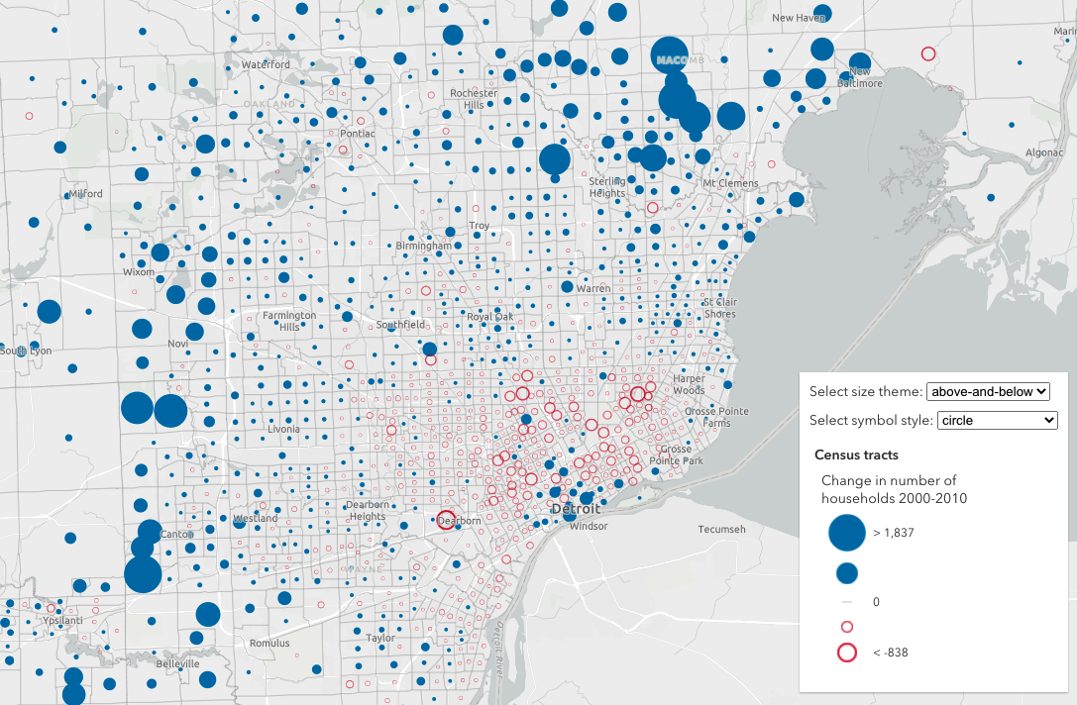
Change in households, 2000-2010

Slide 17
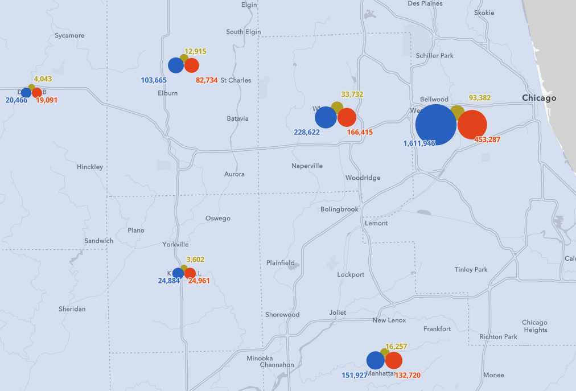
Multivariate composite symbols
Diverging datasets
+

Slide 18
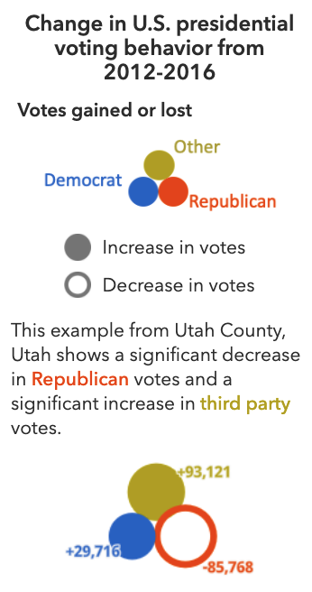

Slide 19
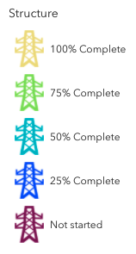
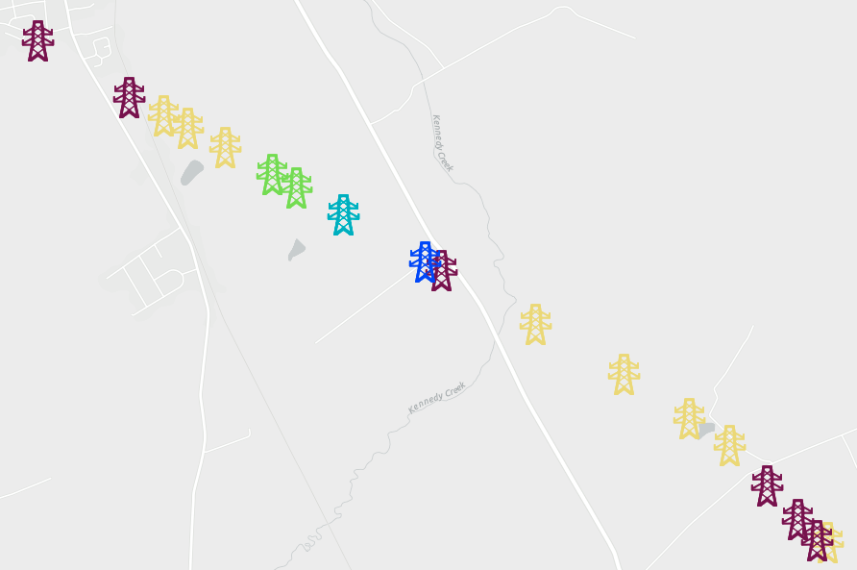
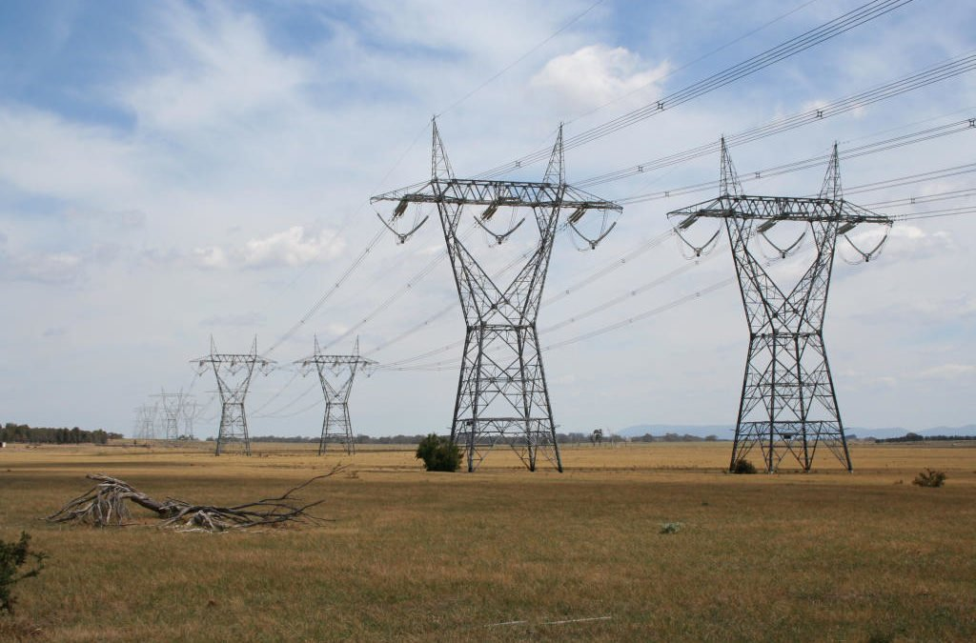
(Marcus Wong via Wikimedia Commons)

Slide 20
Project status
Wire pull
Structure
Foundation
Pad site
Access Road
25% complete
50% complete
75% complete
100% complete

Slide 21
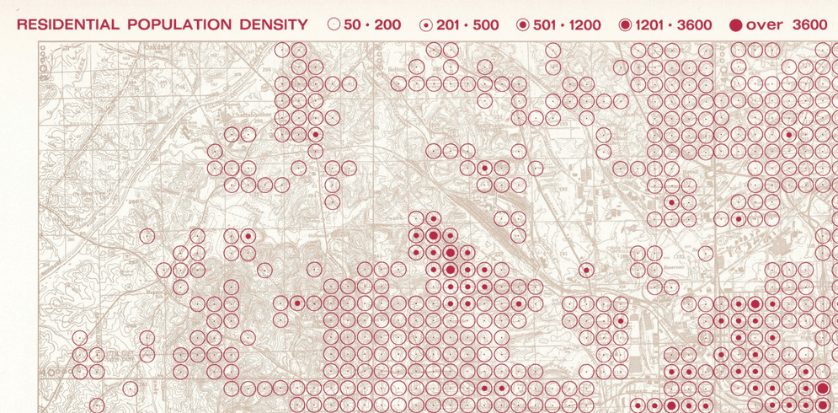

Slide 22
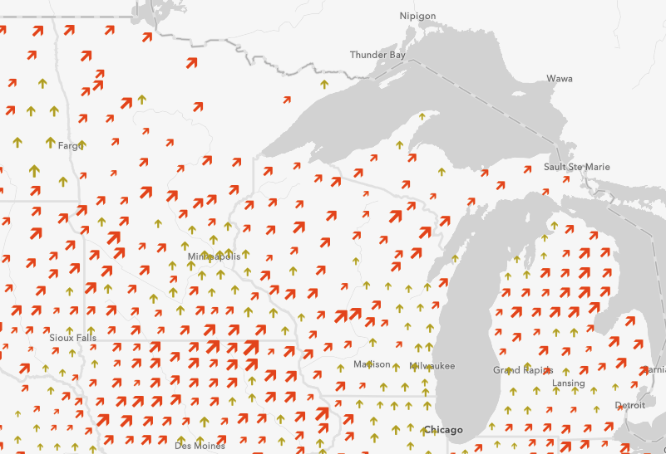
Conclusion
More complexity increases cognitive load
More variables require more effort to understand
BUT it reveals nuances typically hidden in single-variate maps
Headline vs. deep dive map authoring

Slide 23
Blogs
Electoral swing in the 2020 U.S. presidential election
Visualize diverging datasets with size in web maps
Visualize electoral swing using composite symbols
Apps and maps
https://ekenes.github.io/elections/
https://ekenes.github.io/election-party-swing

Slide 24
Acknowledgements
Thank you to fellow collaborators Jeremy Bartley, Mark Harrower, Jim Herries, Praveen Ponnusamy, Russell Roberts and others who contributed ideas, designs, feedback, and support throughout this project.

Slide 25




Thank you!
kekenes@esri.com
kristian-ekenes
ekenes
@kekenes
Kristian Ekenes
https://ekenes.github.io/conferences/nacis-2021/

Slide 26
Sources
Ekenes, K. (2021, Feb 3). Visualize diverging datasets with size in web maps. ArcGIS Blog. DOI: https://www.esri.com/arcgis-blog/products/js-api-arcgis/mapping/visualize-diverging-datasets-with-size-in-web-maps/
Ekenes, K. (2021, Jan 20). Electoral swing in the 2020 U.S. presidential election. ArcGIS Blog. DOI: https://www.esri.com/arcgis-blog/products/js-api-arcgis/mapping/electoral-swing-in-the-2020-u-s-presidential-election/
Ekenes, K. (2021, Oct 5). Visualize electoral swing using composite symbols. ArcGIS Blog. DOI: https://www.esri.com/arcgis-blog/products/js-api-arcgis/mapping/visualize-electoral-swing-using-composite-symbols/
Nelson, J. (2017, May 4) Happy Maps. ArcGIS Blog. DOI: https://www.esri.com/arcgis-blog/products/analytics/analytics/happy-maps/
Nelson, J. (2020). Multivariate Mapping. The Geographic Information Science & Technology Body of Knowledge (1st Quarter 2020 Edition), John P. Wilson (ed.). DOI: 10.22224/gistbok/2020.1.5
The New York Times. (2017, Aug 9) 2016 Presidential Election Results. The New York Times. DOI: https://www.nytimes.com/elections/2016/results/president
Wurman, R. S. (1966) Urban Atlas: 20 American Cities.

